Slide 1
Overview of the New Long-Term Care Survey Process
For Long-term care (LTC) Providers

Slide 2
Navigation
To Start the training, please press Function + F5
To advance through each slide use the icon located at the bottom of each page
To return to the previous slide use the icon located at the bottom of each page
To Exit the presentation, press the “Esc” key and then click on the X in the upper right hand corner of the presentation.

Slide 3
Presentation Outline
Overview of Regulatory Reform
Rationale Behind the Changes to the LTC Survey Process (LTCSP)
Key Changes to the Survey Process
Comparison of the Three Survey Processes
Overview of New LTCSP:
Entrance / Entrance Conference
Day One
Day Two
Remainder of Survey
Exit Conference
Conclusion

Slide 4
Overview of Regulatory Reform
LTC Survey process

Slide 5
Overview of Regulatory Reform
Regulatory reform has created numerous changes to the regulations that govern long-term care; however, providers should be aware a lot has not changed:
Many of the minimum quality standards from the previous regulations have remained in the new regulatory reform,
The use of the minimum data set (MDS) to do assessments and care planning based on resident goals and preferences and to include input from the interdisciplinary team,
Medical Director requirement,
Full-time nurse requirements, and
Medication reviews for residents.

Slide 6
Overview of Regulatory Reform (continued)
The regulation reform implemented a number of pieces of legislation from the Affordable Care Act (ACA) and the Improving Medicare Post-Acute Care Transformation (IMPACT) Act, including the following compliance and ethics programs:
Quality Assurance and Performance Improvement (QAPI),
Reporting suspicion of a crime,
Increased discharge planning requirements, and
Staff training.

Slide 7
Regulatory Reform Phased Implementation

Slide 8
Rationale Behind the Changes LTC SURVEY PROCESS

Slide 9
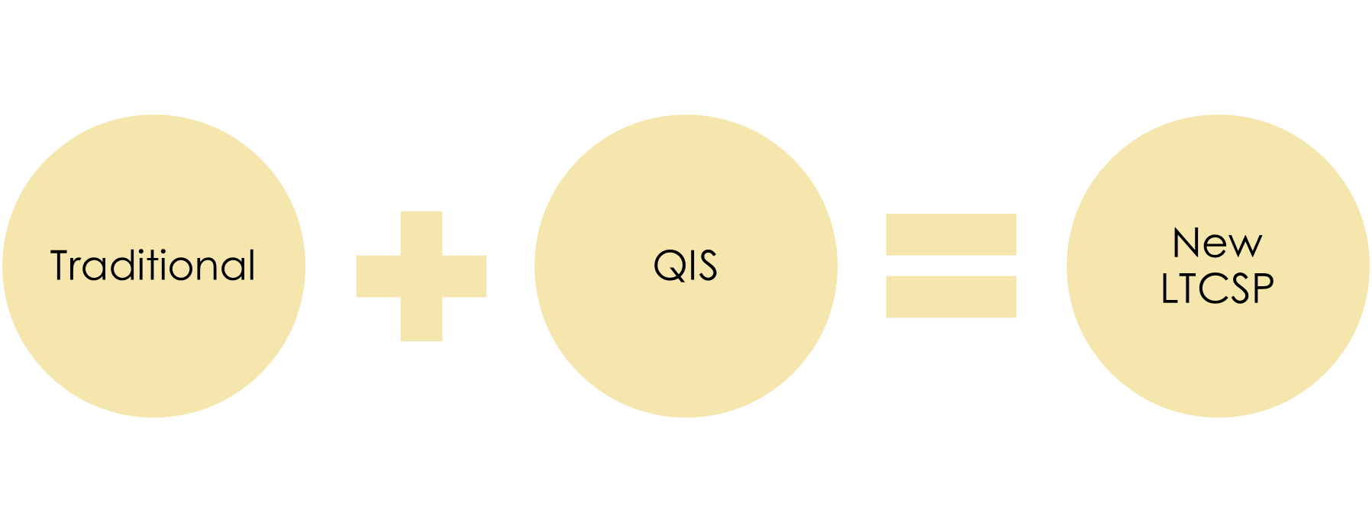
Intent of Changes to the LTC Survey Process

Slide 10
Purpose of Changes to the LTC Survey Processes
Purpose of the changes:
Develop one process for use across the nation
Promote consistency
Conduct consistent, organized, and systematic investigations
Focus on person-centered care.

Slide 11
Key Changes to the LTC Survey Process
Key changes to the survey process:
Survey sampling
Resident-centered process
Focus on resident-centered outcomes
Focus on quality of care and quality of life
New triggered task.

Slide 12
Better Than the Rest!
What makes this process better?
Consistency in surveys
Consistent training model
Effective and efficient process
Computer based / software supported
Resident-centered
Shared processes between States and CMS.

Slide 13
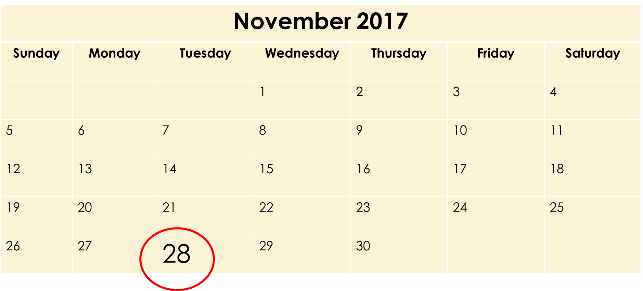
Implementation of the New LTC Survey Process

Slide 14
Comparison of the Three Survey Processes LTC SURVEY PROCESS

Slide 15
Automation

Slide 16
Sample Selection

Slide 17
Off-Site

Slide 18
Information Needed Upon Entrance

Slide 19
Initial Entry Into Facility

Slide 20
Survey Structure

Slide 21
Group Interviews

Slide 22
Keeping Residents Informed
Providers should take time to inform residents of the regulatory changes that govern long-term care. Additionally, providers should inform residents that a new survey process will be implemented on 11/28/2017.
Residents should be informed about the survey process and that, during the survey, surveyors will be:
Asking questions about the care they receive
Observing staff and residents throughout the survey
Using computers when speaking with them
Using computers when making observations throughout the facility.

Slide 23
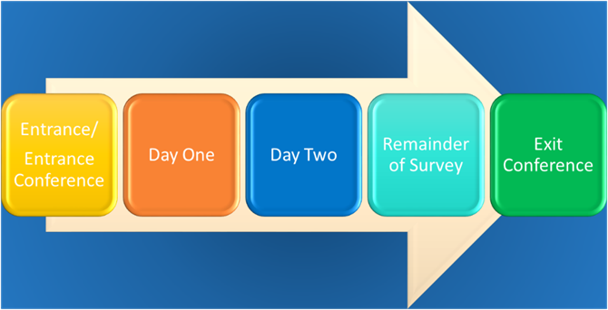
New LTC Survey Process Overview
LTC Survey Process

Slide 24
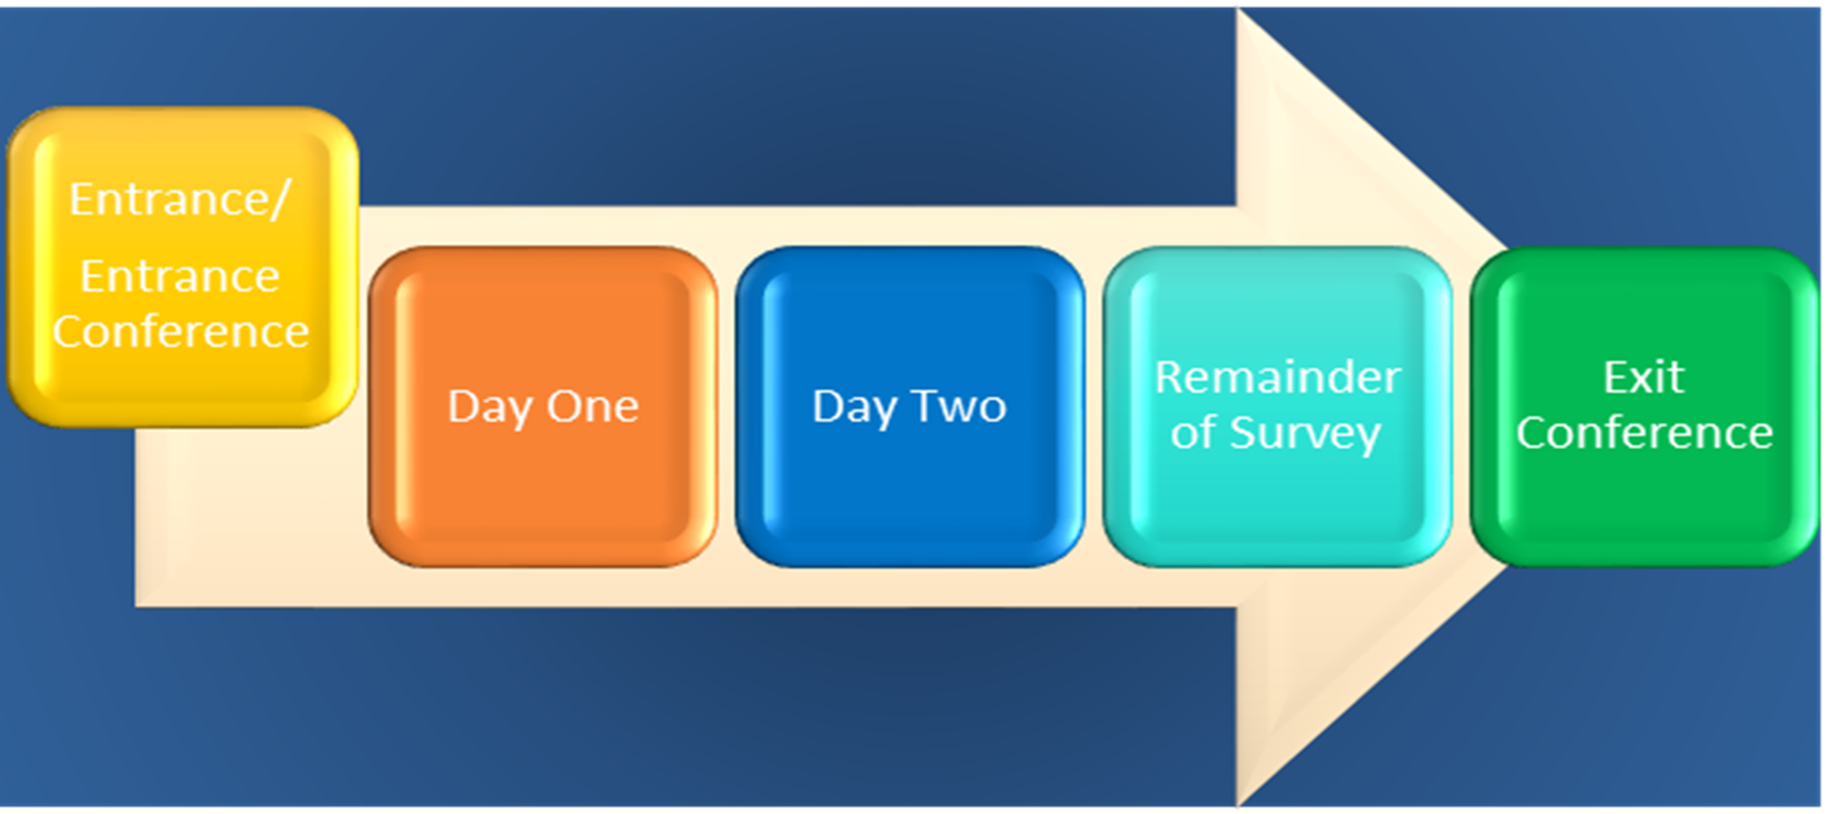
Entrance/Entrance Conference
LTC Survey Process

Slide 25
Entrance Into the Facility
Upon entry into the facility the Team Coordinator (TC) will:
Introduce themselves and the survey team, and request to see the Administrator and/or Director of Nursing (DON)
Request the facility provide a place where the survey team can work
Schedule the Entrance Conference with the Administrator and/or DON
Request information needed immediately upon entrance.

Slide 26
Entrance Conference Form

Slide 27
Entrance Conference
At the scheduled time, the TC will:
Conduct a brief Entrance Conference with the Administrator/designee
Provide a copy of the Entrance Conference form
Request information regarding a full-time DON
Request information about the facility's emergency water source (verbal confirmation is acceptable)
Provide signs announcing the survey, which should be posted in high-visibility areas
Request a copy of an updated facility floor plan, if changes have been made
Request the name of the Resident Council President
Provide the Administrator or designee with a copy of the CASPER 3 report.

Slide 28
Information Needed Immediately Upon Entrance
Facility census number
Complete matrix for new admissions in the last 30 days who are still residing in the facility
An alphabetical list of all residents
A list of residents who smoke, designated smoking times, and locations.

Slide 29
Matrix for Providers

Slide 30
Information Needed Within One Hour of Entrance
Schedule of meal times, locations of dining rooms, copies of all current menus – including therapeutic menus that will be served for the duration of the survey – and the policy for food brought in from visitors
Schedule of Medication Administration times
Number and location of medication storage rooms and medication carts
The actual working schedules for licensed and registered nursing staff for the survey time-period
List of key personnel, location, and phone numbers. Also note contract staff (e.g., rehab services)

Slide 31
Information Needed Within One Hour of Entrance (continued)
If the facility employs paid feeding assistants, provide the following information:
Whether the paid feeding assistant training was provided through a State-approved training program by qualified professionals as defined by State law, with a minimum of 8 hours of training
The names of staff (including agency staff) who have successfully completed training for paid feeding assistants, and who are currently assisting selected residents with eating meals and/or snacks
A list of residents who are eligible for assistance and who are currently receiving assistance from paid feeding assistants, if applicable.

Slide 32
Information Needed Within Four Hours of Entrance
Complete matrix for all other residents residing in the facility
Admission packet
Dialysis contract(s), agreement(s), arrangement(s), and policy and procedures, if applicable
List of qualified staff providing hemodialysis or assistance for peritoneal dialysis treatments, if applicable
Agreement(s) or policies and procedures for transport to and from dialysis treatments, if applicable
Whether the facility has an on-site, separately certified, End-Stage Renal Disease (ESRD) unit

Slide 33
Information Needed Within Four Hours of Entrance (continued)
Hospice Agreement and Policies and Procedures for each hospice used (name of facility designee(s) who coordinate(s) services with hospice providers)
Infection Prevention and Control Program Standards, Policies and Procedures, and Antibiotic Stewardship Program
Influenza/Pneumococcal Immunization Policy and Procedures
QAA committee information (name of contact, names of members, and frequency of meetings)
QAPI Plan

Slide 34
Information Needed Within Four Hours of Entrance (continued)
Abuse prohibition policy and procedures
Description of any experimental research occurring in the facility
Facility wide assessment
Nurse staffing waivers
List of rooms meeting any one of the following conditions that require a variance:
Less than the required square footage
More than four residents
Below ground level
No window to the outside
No direct access to an exit corridor.

Slide 35
Information Needed by the End of the First Day
Facility should provide each surveyor with access to all resident Electronic Health Records (EHRs) – do not exclude any information that should be a part of the resident's medical record. Provide specific information on how surveyors can access the EHR outside of the conference room. Providers will complete the attached form on page 2, titled "Electronic Health Record (EHR) Information."

Slide 36
Electronic Health Record (EHR) Information

Slide 37
Information Needed Within 24 Hours of Entrance
Completed Medicare/Medicaid Application (CMS-671)
Completed census and condition information (CMS-672)
Completed Beneficiary Notice worksheet that identifies those residents discharged from Medicare covered Part A stay with benefit days remaining within the last six months.

Slide 38
Beneficiary Notices – Discharged Resident Listing

Slide 39
Communication
Ongoing communication occurs throughout the survey between surveyors and facility staff.
Day One findings are preliminary and surveyors are unable to discuss findings with staff, unless a situation of Immediate Jeopardy (IJ) is identified.
Surveyors will communicate with all levels of facility staff (e.g., dietary, housekeeping, certified nursing aides, nurses, contractors, management, etc.).
Ongoing concerns will be discussed with staff as investigations progress. Staff will be able to clarify any identified concerns.
Staff are encouraged to report surveyors' questions/concerns to their supervisors.

Slide 40
Day One Overview
LTC Survey Process

Slide 41
Day One
TC reports to assigned area after completion of Entrance Conference.
Surveyor assigned kitchen task conducts a brief kitchen tour and then reports to their assigned area.
All other surveyors report to assigned areas and immediately begin:
Resident/Resident Representative Interviews and Observations
Records Review
Staff interviews (no formal staff interviews during Day One)
Dining/room tray observations.

Slide 42
Resident/Resident Representative Interviews and Observations
Critical component of resident-centered approach
Upon arrival to each unit, surveyors will request a list of new admissions (in addition to the facility matrix)
Resident interviews and observations are conducted for the following residents:
MDS pre-selected residents
Vulnerable
New admissions
Complaint and/or Facility Reported Incidents (FRIs)
Residents with other identified concerns
Minimum of 3 resident representative interviews.

Slide 43
Limited Record Review
Surveyors will conduct limited record reviews, including, but not limited to:
Obtain specific care area information for non-interviewable residents (e.g., falls, wandering, elopement, pressure ulcers, weights, infections, etc.)
Verify information provided by the resident/representative
Clarify identified discrepancies
Identify high risk medications
Review advanced directives.

Slide 44
Staff Interviews
No formal staff interviews during the initial pool process.
Special circumstances:
Inability to access EHRs
Time constraints
Etc.

Slide 45
Dining and Room Tray Observations
First full meal after entry into the facility:
All dining areas are covered, including room trays
If there are more dining areas than surveyors, surveyors will monitor dining rooms for those residents who require the most assistance.
Note: Additional dining/room tray observations will be conducted as needed.

Slide 46
Day One Overview
Entrance Conference
Kitchen Tour
Resident Interviews/Observations
Resident Representative Interviews
Limited Record Review
Dining Observations
Information Request

Slide 47
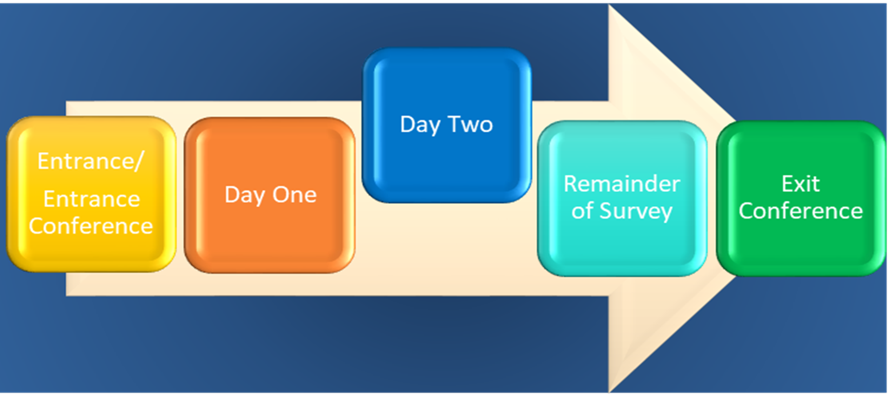
Day Two Overview
LTC Survey Process

Slide 48
Day Two
Complete Initial Pool Process
Resident Sample Selection:
Off-site selected residents
Vulnerable residents
New admissions
Harm, Substandard Quality of Care (SQC) if suspected, or Immediate Jeopardy (IJ) if identified
Complaints/Facility Reported Incidents
Unnecessary Medication Review for five residents
Three closed records (death, hospitalization, community discharge).

Slide 49
Day Two (continued)
Once the sample has been finalized, surveyors will:
Begin in-depth investigation for sampled residents
Investigate complaints and/or facility-reported incidents, if any
Ask questions of non-clinical, clinical, and/or administrative staff
Request copies of records and policies, as needed
Initiate an investigation of care issues for any resident, if the need arises; these residents will be added to the total resident sample.

Slide 50
Day Two Overview
Complete Initial Pool Process
Interviews
Observations
Limited records review
Resident Sample Selection
In-depth Investigations

Slide 51
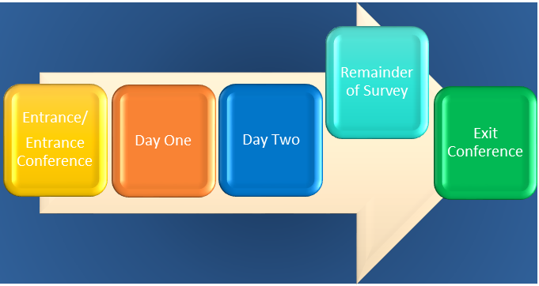
Remainder of Survey
LTC Survey Process

Slide 52
Remainder of Survey
The remainder of the survey, surveyors will:
Continue In-depth Investigations,
Complete Mandatory Facility Tasks:
Dining (second observation, as needed)
Infection Control / Antibiotic Stewardship
Skilled nursing Beneficiary Notification
Kitchen
Medication Administration / Storage
Resident Council Meeting
Sufficient and Competent Staffing
Quality Assessment and Performance Improvement.

Slide 53
Remainder of Survey (continued)
Triggered Facility Tasks:
Personal Funds
Environment
Resident Assessment (new triggered task):
Delay with completion of MDS assessments
Delay with submission of MDS assessments
MDS Discrepancies.

Slide 54
Skilled Nursing Beneficiary Protection Notification Review

Slide 55
Potential Citation Review
Once the survey team has completed all of their in-depth investigations and facility tasks, the team will conduct one final meeting to:
Discuss pertinent survey findings
Discuss potential non-compliance
Determine potential citations.

Slide 56
Remainder of Survey Overview
Continued In-depth Investigations
Mandatory Facility Tasks
Triggered Facility Tasks
Potential Citation Review

Slide 57
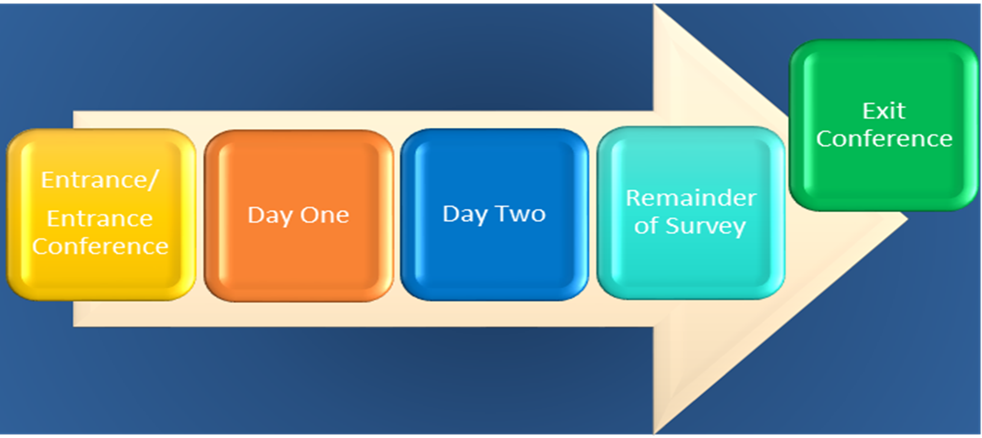
Exit Conference
LTC Survey Process

Slide 58
Exit Conference
The exit conference is conducted in the same manner as previous surveys.
The exit conference should include the Administrator, Director of Nursing, Resident Council President, up to two interested residents if applicable, and the Ombudsman.
During the exit conference the TC will:
Report potential findings of non-compliance under regulatory headings and identify facts related to non-compliance (i.e. number of residents)
Report preliminary findings, avoiding specific scope/severity determination, unless there is an Immediate Jeopardy
Advise the provider that these findings are preliminary and not finalized until receipt of the statement of deficiencies, the CMS-2567.

Slide 59
Conclusion
This training has provided you with an in-depth overview of :
Regulatory Reform
Rationale Behind the Changes to the New Survey Process
Key Changes to the Survey Process
Comparison of the Three Survey Processes
New LTC Survey Process.
Note: All survey documents outlined in this training can be located at: https://www.cms.gov/Medicare/Provider-Enrollment-and-Certification/GuidanceforLawsAndRegulations/Nursing-Homes.html
LTC Survey Process

Slide 60
For Further Questions
If you have any further questions please submit all questions regarding the new LTC Survey Process to the Nursing Home Survey Development mailbox at:
NHSurveyDevelopment@cms.hhs.gov

Slide 61
You have completed the Provider Training for the New LTC Survey Process. If you would like to watch this presentation again please click the FORWARD button. To exit, click the X in the upper right-hand corner of your screen.

Slide 62
References
Centers for Disease Control. Core Elements for Antibiotic Stewardship in Nursing Homes. Creating a Culture to Improve Antibiotic use in Nursing Homes. Retrieved from https://www.cdc.gov/longtermcare/pdfs/factsheet-core-elements-creating-culture-improve-use.pdf
Centers for Medicare and Medicaid Services (CMS, 2017). Long-Term Care Survey Entrance Conference and Provider Matrix. Retrieved from: https://www.cms.gov/Medicare/Provider-Enrollment-and-Certification/GuidanceforLawsAndRegulations/Nursing-Homes.html
Centers for Medicare and Medicaid Services (CMS, 2017). Long-Term Care Pathways. Retrieved from: https://www.cms.gov/Medicare/Provider-Enrollment-and-Certification/GuidanceforLawsAndRegulations/Nursing-Homes.html
Federal Register: The Daily Journal of the United States Government (2016). Medicare and Medicaid Programs; Reform of Requirements for Long-Term Care Facilities. A Rule by the Centers for Medicare and Medicaid Services on 10/04/2016. Retrieved from: https://www.federalregister.gov/documents/2016/10/04/2016-23503/medicare-and-medicaid-programs-reform-of-requirements-for-long-term-care-facilities

